Slide 1
Module 9
Forms

Slide 2
Angular provides two different approaches to handling user input through forms:
Reactive forms
Template-driven forms.

Slide 3
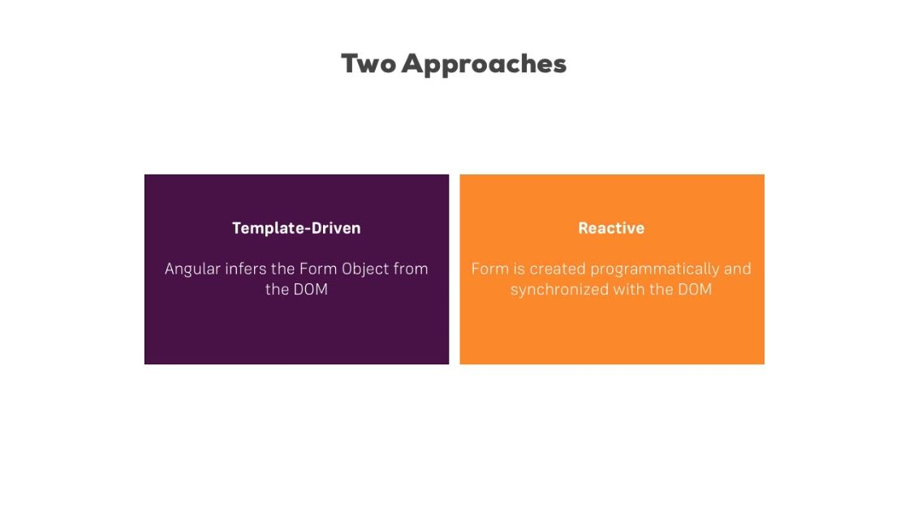

Slide 4
Reactive forms are more robust: they're more scalable, reusable, and testable. If forms are a key part of your application, or you're already using reactive patterns for building your application, use reactive forms.
Template-driven forms are useful for adding a simple form to an app, such as an email list signup form. They're easy to add to an app, but they don't scale as well as reactive forms. If you have very basic form requirements and logic that can be managed solely in the template, use template-driven forms.

Slide 5
Template Driven Form
<form (ngSubmit)="onSubmit(f)" #f="ngForm">
<input type="text" name="name" ngModel required #name="ngModel">
<span *ngIf="!name.valid && name.touched">value is required</span>
<button type="submit" [disabled]="!f.valid">Save</button>
</form>

Slide 6
Reactive form
<form [formGroup]=“form" (ngSubmit)="onSubmit()">
<input type="text" formControlName="name">
<button type="submit" [disabled]=“form.invalid">Save</button>
</form>
form: FormGroup;
this.form = new FormGroup({
'name': new FormControl(‘value’, Validators.required)
});

Slide 7
Form with @ViewChild
A reference to the form object can be gotten using the @ViewChild attribute
@ViewChild(“f”) theForm: NgForm;

Slide 8
Custom Valuation
In it’s simplest form, a validator is really just a function that takes a Control and returns either null when it’s valid, or and error object if it’s not.
function validatePositiveNumber(c: FormControl) {
return /^[1-9]+[0-9]*$/.test(c.value) ? null : {
validatePositiveNumber: {
valid: false
}
};
}

